Slide 1
Introduction to Python Course Title: Programming Language II Course Code: CSE 111 Semester: Summer 2020 Lecture -1

Slide 2
Today’s Lecture
Introduction to Python
History
Beauty of Python
Drawbacks of Python
Applications of Python
Installation of IDE

Slide 3
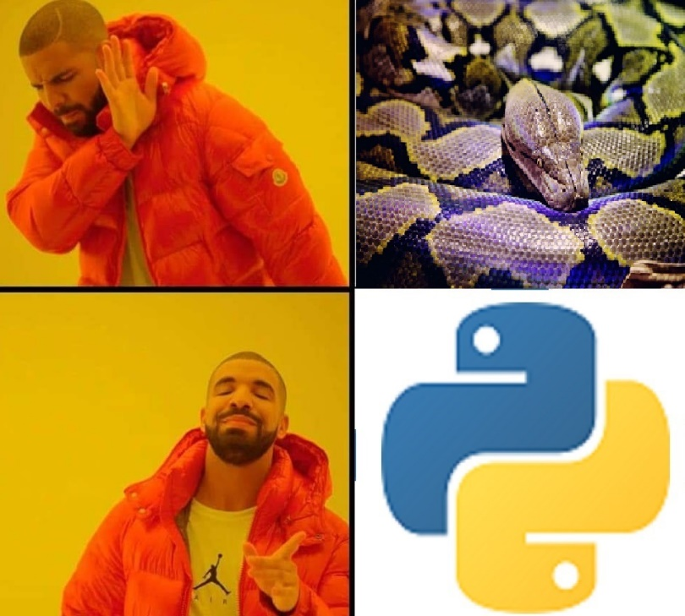
What is Python?
Python is a
High level
Object oriented
Interpreted
programming language with built in high level data structures and enriched libraries.
Interpreted Language
Compiled Language
Level of a programming Language
0100
1100
1111
……..
Abstraction
Programming Language
Machine Code

Slide 4
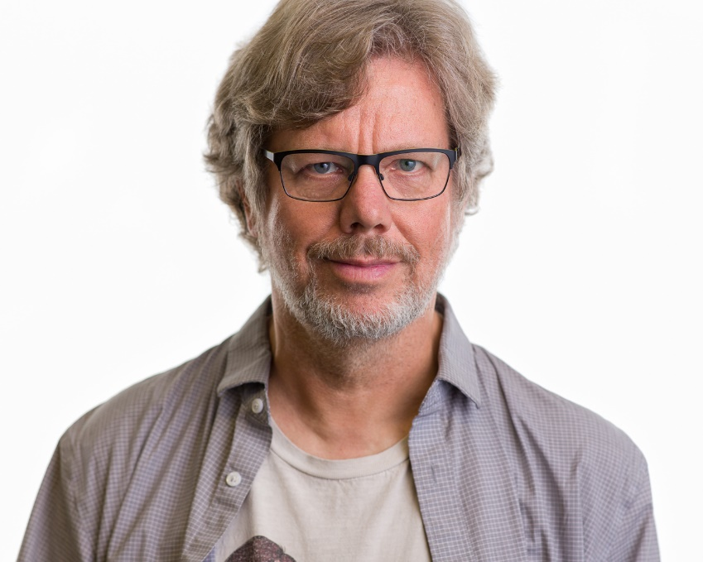
History of Python
Python was introduced by Guido Van Rossum
in 1991.
It was named after Monty Python's
Flying Circus, a BBC comedy series.
Latest version: Python 3(3.8.3)
If you want to know more about Guido and how he
invented Python, please follow this link:
https://www.youtube.com/watch?v=7kn7NtlV6g0
Guido Van Rossum

Slide 5
Beauty of Python
English like language
Enforce clean coding
Cross Platform
Robust standard library, Open source frameworks and tools
General purpose language
Active and supportive community

Slide 6

A simple “Hello World” program
In C :
#include <stdio.h>
int main() { printf("Hello World!\n"); return 0; }
In Python :
print(“Hello World!”)
In Java :
class Tester {
public static void main(String []args){
System.out.println(“Hello World!”);
}
}

Slide 7
Drawbacks of Python
Slow
Weak in mobile development
Database access
Runtime error
Memory consumption
Difficulty in using other languages

Slide 8
Applications of Python
Web Development (Frameworks: Django, Flask, Pyramid, Bottle and libraries to support HTML, XML, Email processing, JSON etc)
Data Science
Machine Learning(SciPy, Ipython, Scikit learn, TensorFlow etc)
Data Analysis and Visualization (Pandas, Matplotlib, Seaborn etc)
Scripting
Desktop GUI applications (Tkinter library, Toolkits like: wxWidgets, PYQT, Kivy etc)
Web Scraping
Software Development(Scons, Buildbot, Apache Gump, Roundup,Trac)
Business Development (Oddo, Tryton)
Game Development(PySoy, PyGame. Example: Civilization IV, Disneys’ Toontown online, Battlefield 2 etc)
Embedded System

Slide 9
Installation of Python and IDE
Please go to this link to get a complete installation guideline on Python.
Integrated Development Environment(IDE)
An integrated development environment (IDE) is a software suite that consolidates basic tools required
to write and test software. In layman’s terms, you will write your codes and projects in IDEs, compile, run
and test the codes to verify your desired output. You will also find a complete reference on IDE installation in
the link mentioned above.
Example of IDEs: PyCharm, Jupyter Notebook, Spyder, Google Colab, Thonny etc.

Slide 10
Summary
Python is an English like high level programming language with enriched libraries and frameworks.
Python has a large domain of application but mostly popular for web development, performing complex mathematics in research works and as a scripting language for different applications.
Like any other language Python has its drawbacks. In spite of the limitations, the benefits Python provides us is a trade off worth taking.

Slide 11
Next Lecture
Variables
Keyword in Python
Data types
User I/O

Slide 12
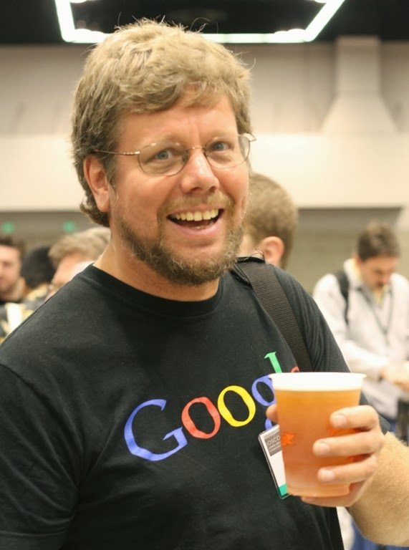
Lets do this!!!!!

